Slide 1
Internet, WWW
And
HTTP!!
BY:
1. Biplove Lamichhane
2. Siddhant Acharya

Slide 2
History of internet
The first workable prototype of the Internet came in the late 1960s with the creation of ARPANET, or the Advanced Research Projects Agency Network.
ARPANET used packet switching to allow multiple computers to communicate on a single network.

Slide 3
History of internet
1971 - Email
1973 - File Transfer Protocol (FTP) established.
Late 1970s - TCP/IP model was developed by two scientists.
1983- Domain Name System introduced
allows naming of hosts, no longer numeric

Slide 4
History of internet
1990 - A scientist at CERN, the European Organization for Nuclear Research, develops Hyper Text Markup Language (HTML).
1991- CERN introduces the World Wide Web to the public.

Slide 5
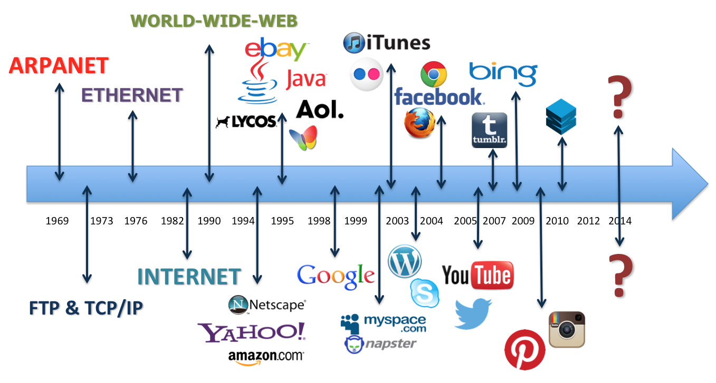
Internet Timeline

Slide 6
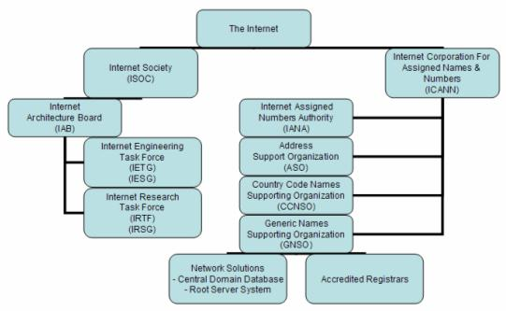
Internet
No one owns it
There is not such a central authority that manages whole internet.
The internet is managed in hierarchical fashion with several organizations on top

Slide 7
The uses of the Internet
Send e-mail messages.
Send (upload) or receive (down load) files between computers.
Participate in discussion groups, such as mailing lists and newsgroups.
Surfing the web.

Slide 8
What is Web?
The Web (World Wide Web) consists of information organized into Web pages containing text and graphic images.
It contains hypertext links, or highlighted keywords and images that lead to related information.
A collection of linked Web pages that has a common theme or focus is called a Web site.
The main page that all of the pages on a particular Web site are organized around and link back to is called the site’s home page.

Slide 9
How to access the Internet?
Students and employees can access through the organization’s local area networks (LAN) or through their own personal computers.
Another way to access the Internet is through Internet Service Provider (ISP).

Slide 10
How to access the Internet?
To access the Internet, an existing network need to pay a small registration fee and agree to certain standards based on the TCP/IP (Transmission Control Protocol/Internet Protocol) reference model.
Each organization pays for its own networks and its own telephone bills, but those costs usually exist independent of the internet.
The regional Internet companies route and forward all traffic, and the cost is still only that of a local telephone call.

Slide 11
How to access the Web?
Once you have your Internet connection, then you need special software called a browser to access the Web.
Web browsers are used to connect you to remote computers, open and transfer files, display text and images.
Web browsers are specialized programs.
Examples of Web browser: Netscape Navigator (Navigator) and Internet Explorer.

Slide 12
Client/Server Structure of the Web
Web is a collection of files that reside on computers, called Web servers, that are located all over the world and are connected to each other through the Internet.
When you use your Internet connection to become part of the Web, your computer becomes a Web client in a worldwide client/server network.
A Web browser is the software that you run on your computer to make it work as a web client.

Slide 13
HTTP
The transfer protocol is the set of rules that the computers use to move files from one computer to another on the Internet.
The most common transfer protocol used on the Internet is the Hypertext Transfer Protocol (HTTP).
Two other protocols that you can use on the Internet are the File Transfer Protocol (FTP) and the Telnet Protocol

Slide 14
History of HTTP:
Hyper Text Transfer Protocal
Why use HTTP
Invented in 1989

Slide 15
HTTP Defination:
It is a instruction or protocol.
Standard everyone follows.
Allows fetching of recourses such as html.
With the use of HTML and HTTP we have the World Wide Web.

Slide 16
Purpose of HTTP:
HTTP is the rules we use over the wire.
Foundation for any data exchange on the web.
It paved the way for the client server protocol.

Slide 17
Lets talk about request:
Web Browser Sends some request to the server.
Form of request are:
Document Files:
HTML
CSS
Javascript

Slide 18
Lets Talk about response:
Two types of response:
Numeric code which tells us about the response from server.
Some data eg. HTML/CSS.

Slide 19
How is it Used?
GET
POST
PUT
DELETE

Slide 20
Example of HTTP

Slide 21
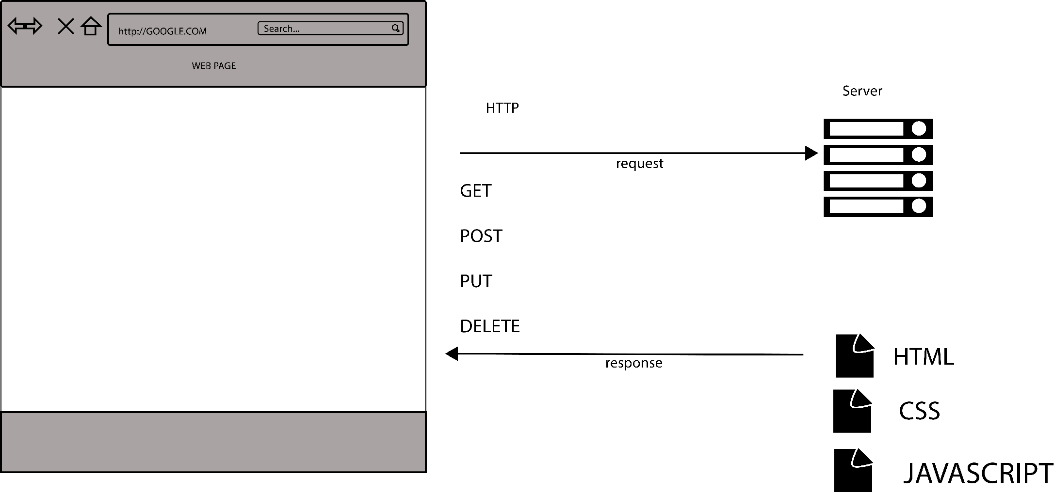
HTTP SIMPLIFIED:

